Slide 1
Introduction
Outline
  Statistical Multiplexing
  Inter-Process Communication
  Network Architecture
  Performance Metrics
  Implementation Issues

Slide 2
Building Blocks
Nodes: PC, special-purpose hardware…
  hosts
  switches
Links: coax cable, optical fiber…
  point-to-point
  multiple access
(a)
(b)
■ ■ ■

Slide 3
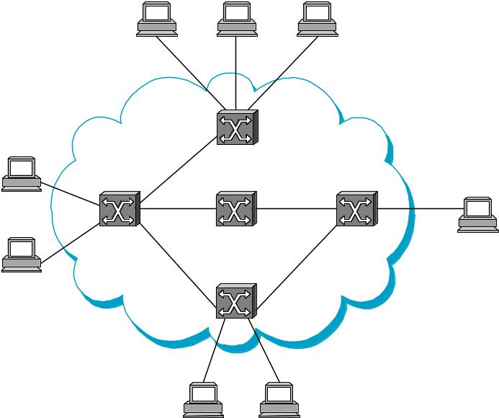
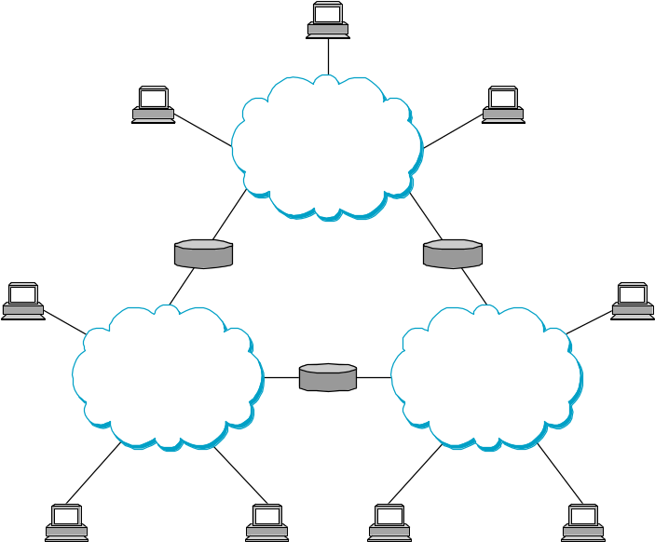
Switched Networks
A network can be defined recursively as...
  two or more nodes connected by a link, or
  two or more networks connected by a node

Slide 4
Strategies
Circuit switching: carry bit streams
  original telephone network
Packet switching: store-and-forward messages
  Internet

Slide 5
Addressing and Routing
Address: byte-string that identifies a node
  usually unique
Routing: process of forwarding messages to the destination node based on its address
Types of addresses
  unicast: node-specific
  broadcast: all nodes on the network
  multicast: some subset of nodes on the network

Slide 6
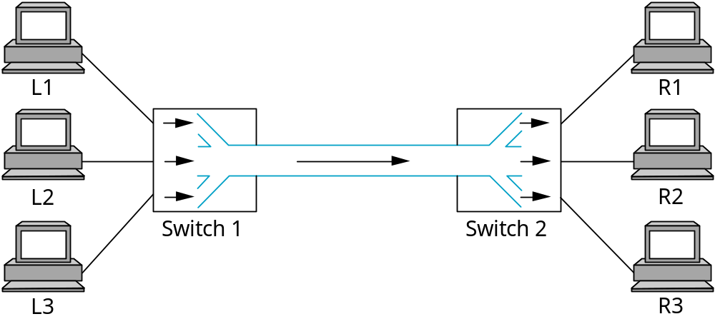
Multiplexing
Time-Division Multiplexing (TDM)
Frequency-Division Multiplexing (FDM)

Slide 7
Statistical Multiplexing
On-demand time-division
Schedule link on a per-packet basis
Packets from different sources interleaved on link
Buffer packets that are contending for the link
Buffer (queue) overflow is called congestion
■ ■ ■

Slide 8
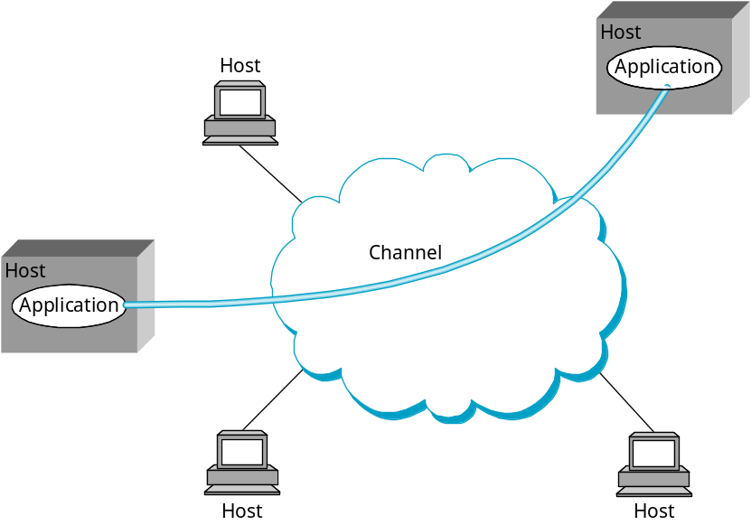
Inter-Process Communication
Turn host-to-host connectivity into process-to-process communication.
Fill gap between what applications expect and what the underlying technology provides.

Slide 9
IPC Abstractions
Request/Reply
  distributed file systems
  digital libraries (web)
Stream-Based
  video: sequence of frames
    1/4 NTSC = 352x240 pixels
    (352 x 240 x 24)/8=247.5KB
    30 fps = 7500KBps = 60Mbps
  video applications
    on-demand video
    video conferencing

Slide 10
What Goes Wrong in the Network?
Bit-level errors (electrical interference)
Packet-level errors (congestion)
Link and node failures
Packets are delayed
Packets are deliver out-of-order
Third parties eavesdrop

Slide 11
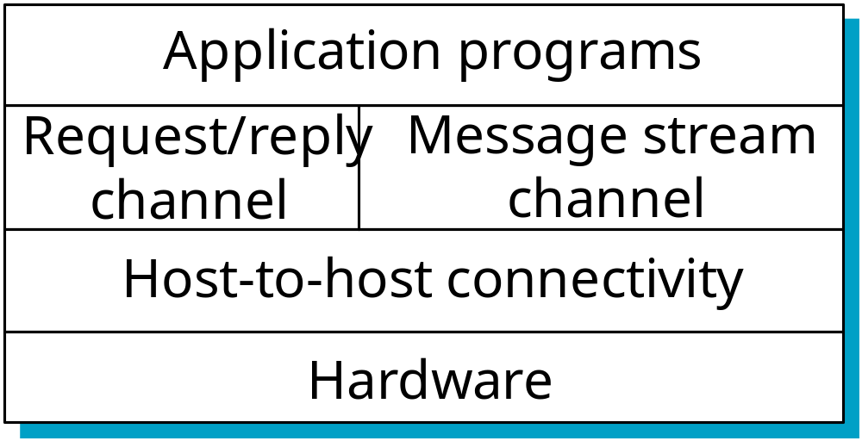
Layering
Use abstractions to hide complexity
Abstraction naturally lead to layering
Alternative abstractions at each layer

Slide 12
Protocols
Building blocks of a network architecture
Each protocol object has two different interfaces
  service interface: operations on this protocol
  peer-to-peer interface: messages exchanged with peer
Term “protocol” is overloaded
  specification of peer-to-peer interface
  module that implements this interface

Slide 13
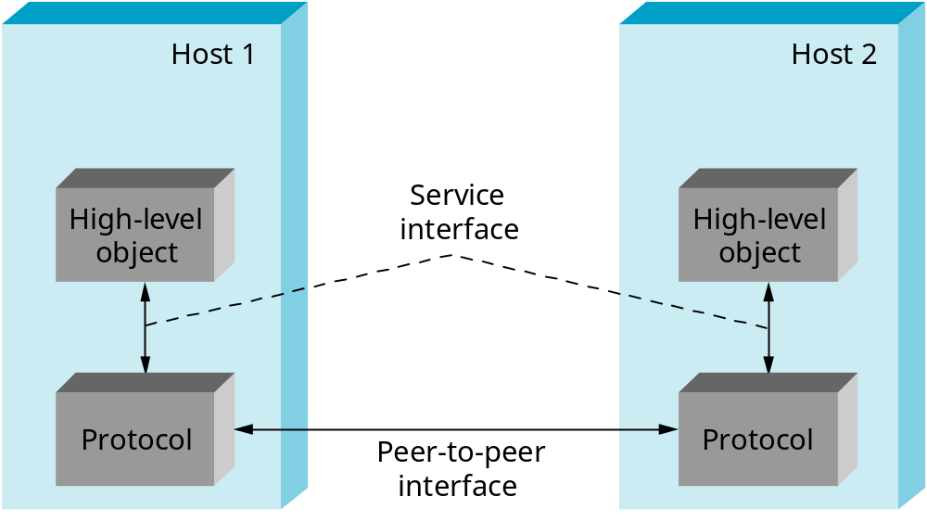
Interfaces

Slide 14
Protocol Machinery
Protocol Graph
  most peer-to-peer communication is indirect
  peer-to-peer is direct only at hardware level
Host 1
Host 2
File
Digital
Video
File
Digital
Video
application
library
application
application
library
application
application
application

Slide 15
Machinery (cont)
Multiplexing and Demultiplexing (demux key)
Encapsulation (header/body)
Host
Host
Application
Application
Application
Application
program
program
program
program
Data
Data
RRP
RRP
RRP Data
RRP Data
HHP
HHP
HHP RRP Data

Slide 16
Internet Architecture
Defined by Internet Engineering Task Force (IETF)
Hourglass Design
Application vs Application Protocol (FTP, HTTP)
FTP
HTTP
NV
TFTP
TCP
UDP
IP
NET
1
NET
2
■ ■ ■
NET
n

Slide 17
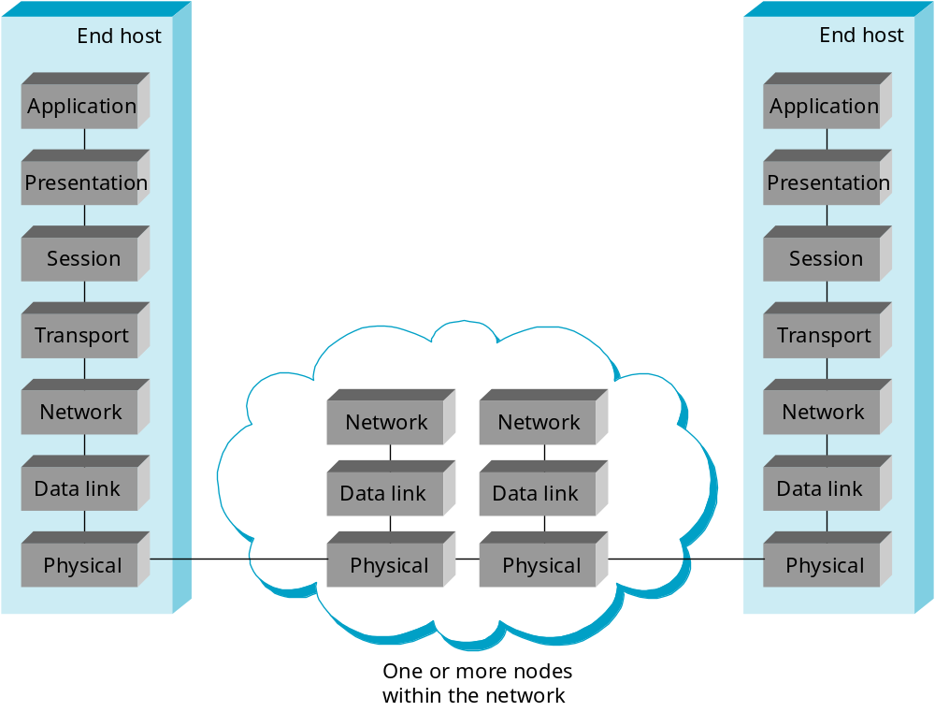
ISO Architecture

Slide 18
Performance Metrics
Bandwidth (throughput)
  data transmitted per time unit
  link versus end-to-end
  notation
    KB = 2¹⁰ bytes
    Mbps = 10⁶ bits per second
Latency (delay)
  time to send message from point A to point B
  one-way versus round-trip time (RTT)
  components
    Latency = Propagation + Transmit + Queue
    Propagation = Distance / c
    Transmit = Size / Bandwidth

Slide 19
Bandwidth versus Latency
Relative importance
  1-byte: 1ms vs 100ms dominates 1Mbps vs 100Mbps
  25MB: 1Mbps vs 100Mbps dominates 1ms vs 100ms
Infinite bandwidth
  RTT dominates
    Throughput = TransferSize / TransferTime
    TransferTime = RTT + 1/Bandwidth x TransferSize
  1-MB file to 1-Gbps link as 1-KB packet to 1-Mbps link

Slide 20
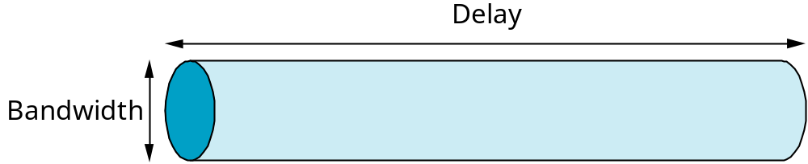
Delay x Bandwidth Product
Amount of data “in flight” or “in the pipe”
Usually relative to RTT
Example: 100ms x 45Mbps = 560KB

Slide 21
Socket API
Creating a socket
  int socket(int domain, int type, int protocol)
    domain = PF_INET, PF_UNIX
    type = SOCK_STREAM, SOCK_DGRAM, SOCK_RAW
Passive Open (on server)
  int bind(int socket, struct sockaddr *addr, int addr_len)
  int listen(int socket, int backlog)
  int accept(int socket, struct sockaddr *addr, int addr_len)

Slide 22
Sockets (cont)
Active Open (on client)
  int connect(int socket, struct sockaddr *addr,
  int addr_len)
Sending/Receiving Messages
  int send(int socket, char *msg, int mlen, int flags)
  int recv(int socket, char *buf, int blen, int flags)

Slide 23
Protocol-to-Protocol Interface
Configure multiple layers
  static versus extensible
Process Model
  avoid context switches
Buffer Model
  avoid data copies

